Slide 1
Independent Writers of Chicago
The Premier Resource for Professional Writers
iwoc.org
Jeff Steele
David Steinkraus
Laura Stigler

Slide 2
The modern media industry
Problems
Fewer people
More work
Less revenue
Equals: Less time for you
Source: American Society of Newspaper Editors/Pew Research Center

Slide 3







But
Specialty websites
Social media
Community papers
Hyperlocal news
Equals: more options
Equals: more work for you

Slide 4
The editor’s inbox
We contacted 16 media outlets, large and small, and asked 3 questions about press releases.
3 replied
100+
41%
Emails per day
Press releases
The lesson: Make their jobs easier

Slide 5
Advertising vs. Press Release
Advertising
Not free ($$$)
Guarantees placement
Does NOT guarantee results
Press Release
FREE!
Does NOT guarantee placement
Does NOT guarantee results
HOWEVER: If you get placed, it’s like free advertising, plus...
More credible: It’s news!
So how can you raise the odds of getting placed?

Slide 6
First things first
What are you promoting? Business or organization? Product? Event?
Ask yourself: Is it newsworthy? (Hence, “press” release)
Why should the reader care?
Entertaining? Helpful? Informative? Topical?
Do research on the publications or broadcast media
Is it relevant to those outlets?
Once you identify your targets, you must grab attention. How?
Notes:
Laura’s story about Preservation Chicago, Ameroc

Slide 7
Anatomy of a press release
Top left: FOR IMMEDIATE RELEASE, date you’re sending it underneath
Top Right: Contact info: name, email, phone (you? or client?)
Headline: MUST grab
  Boil down to the essence: what’s the big news?
  Is there a problem/solution? Relatable to audience?
  Ultimate benefit?
  Could be like newspaper headline – or more creative: Emotional? Funny?
  Could ask a question to draw readers in.

Slide 8
Sample headlines
CLIENT: Rentokil Pest Control
PURPOSE OF RELEASE: To promote the company’s business via a story, make them the go-to guys for pest control and to come across as providing a public service
Original head
(Client requested to rescue this headline and release. Wanted it to be more consumer-friendly.)
MAY IS NATIONAL ASTHMA AND ALLERGY AWARENESS MONTH
BREATHE MORE EASILY: INTEGRATED PEST MANAGEMENT (IPM)
HELPS REDUCE ASTHMA AND ALLERGY SYMPTOMS
Revised “consumer-ese” headline
SUFFERING FROM ALLERGIES? ASTHMA ATTACKS?
CREEPY, CRAWLY CRITTERS COULD BE THE TRIGGERS

Slide 9
Sample headlines
CLIENT: Stew & Donny Music
PURPOSE OF RELEASE: Promote specific product, trumpet its unique selling point, tie-in to upcoming holiday
Ineffective
(Who are Stew & Donny? Doesn’t say “kids.” Lays there.)
STEW & DONNY CREATE PERSONALIZED HALLOWEEN SONG
Much better
(More fun, personalized, mentions kids, sounds special, exciting, appeals to parents.)
A HALLOWEEN SONG THAT HAS YOUR KID’S NAME ON IT: WHAT A TREAT!

Slide 10
Sample headlines
CLIENT: Independent Writers of Chicago
PURPOSE: Announce their upcoming meeting (event), targeting authors who haven’t a clue as to how to get their book(s) published.
Ineffective
(There’s a lot more to this event than meets this blah headline.
Nothing to see here. Move along, folks.)
INDEPENDENT WRITERS OF CHICAGO (IWOC)
LEARN HOW TO GET THEIR BOOK PUBLISHED
Very effective
(Piques interest with a fun question, then tells the whole purpose of the event in a neat nutshell.)
ARE YOU “BOOK” SMART?
FROM WRITING TO MARKETING YOUR BOOK,
INDEPENDENT WRITERS OF CHICAGO (IWOC)
LEARN THE ABCs OF GETTING PUBLISHED

Slide 11
Sample headlines
CLIENT: DanceArt
PURPOSE: Tug at the heartstrings, create awareness of the organization, promote its public service
Acceptable
DanceArt: A COMMUNITY DANCE SCHOOL CATERING TO KIDS AT RISK
Even better
(More emotional, more poetic, befitting the artistic nature of the topic.)
DANCING INTO THE SOULS
OF CHILDREN AT RISK:
The story of DanceArt

Slide 12
Press release body
Have a voice
  Kids event? Have fun!
  Medical device? Be authoritative, knowledgeable.
  Whatever the subject, there’s inherent drama. Convey your excitement as if it’s your own business. Especially when it is!
  Mainly, keep it real and relatable.
First paragraph
  Dateline (where is topic happening?]
  5 W’s: Who, What, When, Where, Why.
  Always write in 3rd person (objective).
  Remember, you have 10 seconds.
Second paragraph
  More detailed about the principals, event, etc.
  Quotes are good.
    Real or made up (get approval).
    Lends credibility.
    Provides a contact within the article. Numbers, stats, figures, surveys, etc. – all good for backing up your point. Check for accuracy.
Notes:
Accuracy does not equal Wikipedia.

Slide 13
FOR IMMEDIATE RELEASE
[date sent out]
CONTACT: LAURA STIGLER
[email & phone]
ARE YOU “BOOK” SMART?
FROM WRITING TO MARKETING YOUR BOOK,
INDEPENDENT WRITERS OF CHICAGO (IWOC)
LEARN THE ABCs OF GETTING PUBLISHED
CHICAGO, IL – [date] You just know you’ve got a book in you. Novel. Cook book. Self-help. Doesn’t matter. But once you’ve gotten the initial brainstorm – where do you go from there? Easy to find out if you come to the next IWOC meeting on Tuesday, January 12th, when Jim Kepler and Kim Bookless dynamically present their acclaimed Jim and Kim Show, or “How to Write, Publish and Market Your Book.” As two IWOC veterans and publishing success stories in their own right, they’ll equip you with their “one-two-three” approach to getting your book written, produced, published and marketed. All time-tested advice that actually works in the real world, whether your aim is to self-publish or go the traditional royalty route.
Jim is the hands-on owner of Adams Press, a 74-year-old specialty book production company catering to small publishers. Consultant, editor and founder of the Chicago Self-Publishing Group, Kim gently but expertly guides indie and self-publishing authors along the path from concept and development to finished books. Together in this info-packed presentation, they will cover the steps that will take your book from incipient idea to selling it in today’s competitive marketplace. They’ll also clearly lay out the pros and cons of self and traditional publishing, how to find a publisher, how to publish your own e-book and much more.
So clear your calendars and come to the meeting. Bring questions, share experiences. Get ready...get set ...get book smart!
The IWOC meeting will take place Tuesday, January 12th in Room 4F (4th fl.) at the Gratz Center, 126 E. Chestnut St. / 115 E. Delaware, Chicago, just west of Michigan Ave., adjacent to Fourth Presbyterian Church. Discounted parking (after 5 pm, with validation) is located at the 900 N. Michigan Ave. garage. Networking at 5 p.m. Main program, 6 p.m. IWOC members admitted free and do not need to register. Nonmembers, $15. ($10 if pre-registered at http://www.iwoc.org/calendar. Click on “January 12th IWOC Meeting.”) Following the meeting, attendees are invited to a nearby restaurant for a buy-your-own dinner to further discuss writing-related topics or to continue networking. For more information, call 800-804-IWOC (800-804-4962) or visit www.iwoc.org.

Slide 14
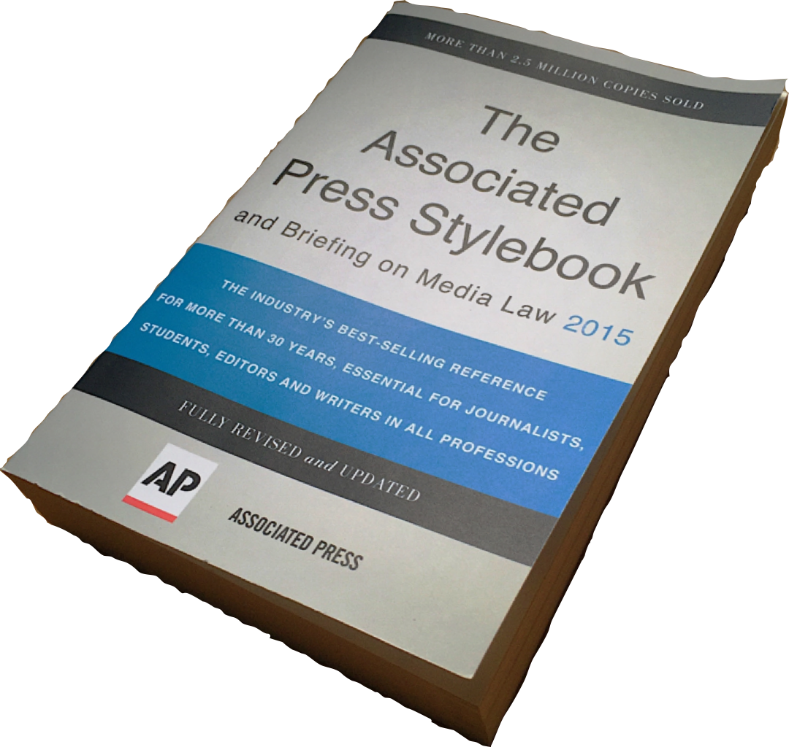
Rules of thumb
Easy to understand and use. So avoid jargon, unless you’re speaking to a specialized audience.
Spelling and grammar check – don’t depend on AutoCorrect
Write simply
Have someone else proofread
Editors and writers thrive on accurate numbers
Links if appropriate (for more info)
Edit ruthlessly
Standard format but new or unexpected content
Think pictures (high resolution)
Think video (link to social media)
Notes:
Laura: Hemingway and Faulkner on the use of big words.

Slide 15
Don’t do this
From: Desiree Kaveolook <desiree@furniture.com>
To: info@iwoc.org
Subject: Furniture Retail Sales Finder
Date: Thu, 9 Mar 2017 09:50:48 -0500
Dear IWOC,
I recently found your web page here with valuable furniture-related resources: http://www.iwoc.org/
Would you also please consider linking to Furniture.com?
It is the most comprehensive furniture website around - think of it as all things furniture! It is designed to be a one-stop shop for furniture, home decor, and mattresses from major national retailers.
What sets it apart from other furniture sites is our super useful Sales Finder, which you can see here:
https://www.furniture.com/sales
The Sales Finder makes it quick and easy for users to search for all the best local deals and furniture sales by zip code.
If you feel it would be a beneficial resource to your visitors, please consider adding a link on your website.
Feel free to contact me with any questions or concerns you may have.
Thank you!
Desiree
Come on, we’re writers. Furniture doesn’t get more complicated than chairs and desks.

Slide 16
When this was sent, faircloud.com was a blank web page, useless if someone needs more information. And how do you phone or text?
FOR IMMEDIATE RELEASE
Press Contact: Alec Morris, Director alec@faircloudpark.com
Rust Begins Filming in Oklahoma
Faircloud Park, LLC, in association with the Oklahoma Film + Music Office (OF+MO) is pleased to announce production of the feature film Rust to be filmed entirely in Oklahoma. The film will utilize the Oklahoma Film Enhancement Rebate Program administered by OF+MO and will begin principal photography on April 22 in Oklahoma City.
Rust is a science fiction drama set in rural Oklahoma during the aftermath of a second civil war in which tensions run high between a society in which robots and humans co-exist. When an innocent woman is found murdered in her trailer, old wounds are ripped open with disastrous consequences for the entire community including a local sheriff who struggles to find compassion for those on both sides of the law in the hopes of preventing further violence.
The film relies heavily on cutting-edge computer-generated effects, set against the picturesque backdrop of Oklahoma’s natural landscapes. Writer/Director and Visual Effects Supervisor Alec Morris spoke about this contrast. “When you spend hours and hours in front of a computer monitor working on computer generated robots, there’s something really breathtaking about just stepping outside and walking around in the natural beauty of our state. When I wrote Rust, I wanted to find a way to combine the two elements in a way I don’t think has been done very often in sci-fi films.”
“The number of local filmmakers like Alec producing work in the state and utilizing our incentive program continues to increase,” said OF+MO Director Tava Maloy Sofsky. “With this increase, Oklahoma continues to see growth in economic impact, jobs creation and workforce training opportunities. We are looking forward to working with Alec on his feature length debut, and look forward to seeing how creatively he captures Oklahoma’s scenic locations on screen with his unique story.”
This is a crumb of news (title, it’s filming, and when). The rest is of interest only to people associated with Oklahoma government.
Ah, actual news.
No more news, instead a plug for the natural beauty of Oklahoma.
A plug for the local benefits of the Oklahoma film program. Again, of limited interest.

Slide 17
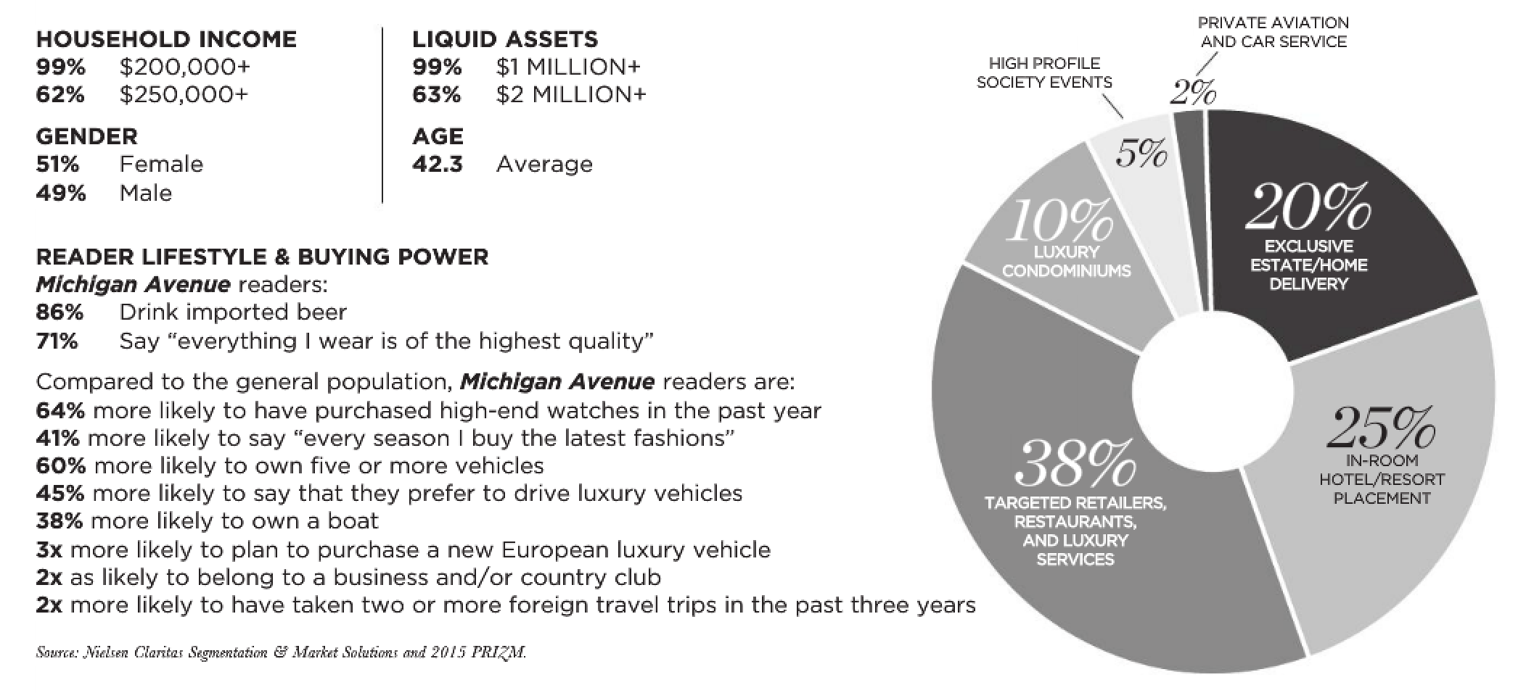
Distributing the release
Services may be OK, but many are shotguns — no focus, no knowledge of the publication.
Media guides at the public library.
Send to a specific person.
Form a relationship with a reporter or editor — difficult but not impossible.
Follow up politely. You never know when something is inadvertently buried.
Know the deadline. Beat it. Editorial calendar on the website.
Remember your hometown media.
Nothing guarantees coverage.
Michigan Avenue Magazine
Notes:
There are paid and free services. Try a Google search.

Slide 18
Editors say
“I can say that most editors’ pet peeves are the following: voicemails “following” up to see if we received an email, and emails following up to see if we received an email. That only crowds our inboxes and slows us down even more.”
Understand our publication — please
“When dealing with neighborhood papers know the boundaries and other criteria before sending information to that editor.”
“You’d be surprised how many press releases we get regarding reviewing books. We don’t even review books.”
“Many of these releases are from LA-NY publicists and PR firms announcing new films or local events that have no correlation to our Chicago film industry readers who make their living here.”
Notes:
You’ll notice a contradiction on following up. The difference is what you’re sending and how you do it.

Slide 19
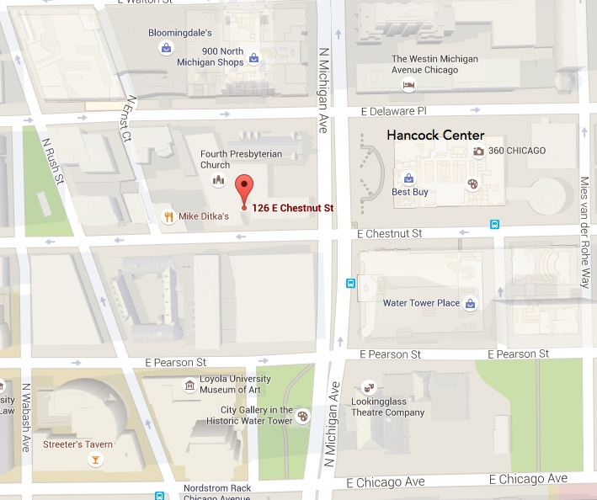
Learn with us
These notes: iwoc.org/general-resources
IWOC meeting: 2nd Tuesday of the month
Gratz Center of Fourth Presbyterian Church
126 E. Chestnut St., Chicago
$10 for non-members, but
FREE for the first meeting through the website
Satellite groups: IWORP, IWOOP, IWOLF
Calendar and meeting topics: iwoc.org
Notes:
Introductions

Slide 20
¿Questions?

